Slide 1
EIN 5226 Lecture 2
Voice of the Customer and S⁴/IEE Define Phase
Chapter 2
Karen E. Schmahl Ph.D., P.E.

Slide 2
Chapter 2 Voice of the Customer and S⁴/IEE Define Phase

Slide 3

Introduction
Key system outputs of an organization should be tracked as a process.
Customer satisfaction: common metrics to all
Voice of customer
Knowledge-centered activity (KCA) describes efforts for wisely obtaining knowledge, and then utilizing this knowledge within organizations and processes.

Slide 4
2.1 Voice of the Customer: Some Facts
Most customers do not complain if a problem exists
50% encounter a problem but do not complain
45% complain at the local level
5% complain to top management
On problems with loss of over $100 and resolved
only 45% of customers will purchase again
only 19% if not resolved
Word-of-mouth behavior is significant.
If a large problem is resolved to the customer’s satisfaction, about 8 persons will be told about the experience.
If dissatisfied with the resolution, 16 others will be told.

Slide 5
Complaint Responses
Official 0.1%
Unofficial
Heard
Issued
B. Joiner, 1996
4-4c

Slide 6
2.1 Voice of the Customer: More Facts
The end user of a product is NOT the only customer.
Internal customers
External customers: End user, Intermediate customers
Need variety of sources to capture Voice of the Customer
Surveys, Interviews, Focus groups
Feedback/Complaint process
Quality Function Deployment (Ch. 13)

Slide 7
Figure 2.1 Kano Diagram: Satisfied Feeling vs Condition
Satisfied Feeling
Delighters
Attractive quality
Physically Fulfilled Condition
Satisfiers
(One-dimensional quality)
Dissatisfiers
(Take it for granted quality)

Slide 8
2.2 A Survey Methodology to Identify Customer Needs
Determine survey objectives
Develop survey
Conduct brainstorming session(s) to identify a wish list of features, problem resolutions, and so forth.
Rank the ideas, if too many.
A set of questions is determined and worded from a positive point of view.
Administer survey
Analyze survey - Perceptual map format
Use data to identify improvement need

Slide 9
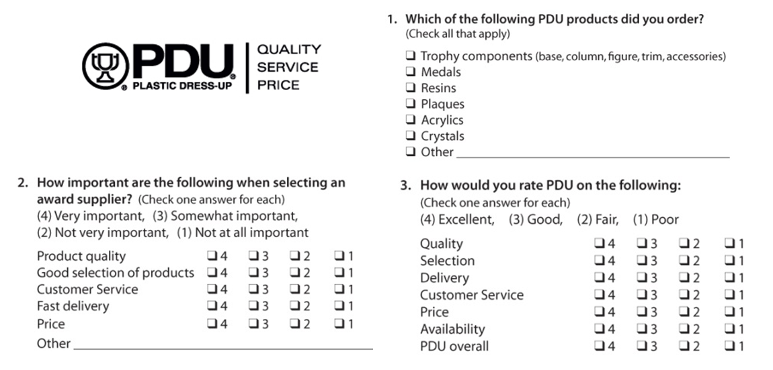
http://www.cavanessmarketing.com/pdu_customer_survey.jpg

Slide 10
2.2 A Survey Methodology to Identify Customer Needs
Importance
8
4
2
1
7
6
3
9
5
Satisfaction

Slide 11
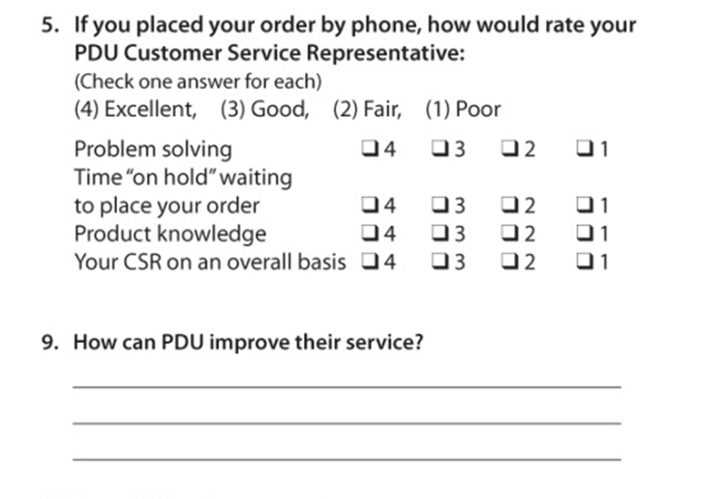

Slide 12
2.3 Goal Setting and Measurements
Goals are to be SMART: Simple, Measurable, Agreed to, Reasonable, and Time-based.
Situation 1: A goal to get house work done on a Saturday.
Situation 2: A goal to make 50% return on your investment.

Slide 13
Is this SMART?
Goal/ projection
Year end actuals

Slide 14
2.4 Scorecard: Balanced Scorecard
Financial:
Inventory levels
Cost per unit
Hidden factory
Activity-based costing
Cost of poor quality (COPQ)
Cost of doing nothing diff (CODND)
Overall project savings
Internal Process:
Defects: DPMO, Sigma quality level
On-time shipping
Rolled throughput yield
Cycle time
Volume hours
Baseline measurements
KPIVs
Customer:
Customer satisfaction (CTQ)
On-time delivery
Product quality (KPOV)
Safety
Communications
Learning and Growth:
6σ tool utilization
Quality of training
Meeting effectiveness
Lessons learned
# of Employees trained in 6σ
Project schedule vs. actual progress
# of projects completed
Total $ saved on 6σ projects

Slide 15
Perspective | Measure | Good | Bad |  | January | Febuary | March
Financial | Material Cost to Gross Revenue | 28 | 34 |  | 34 | 31 | 32
 | Operating Margin | 0.28 | 0.23 |  | 0.24 | 0.21 | 0.22
 | Scrap & Rework | 0.03 | 0.06 |  | 0.03 | 0.03 | 0.05
Customer | Satisfaction rating | 97% | 92% |  | 98% | 97% | 97%
 | On time delivery | 95% | 85% |  | 85% | 82% | 83%
 | Inventory Available | 98% | 93% |  | 99% | 98% | 97%
Internal | Operator % to standard output | 100% | 95% |  | 110% | 105% | 105%
 | Cycle time days | 5 | 7 |  | 4.5 | 5.0 | 4.8
 | 1st time test yield | 95% | 85% |  | 96 | 94% | 92%
Learning | Employee turnover | 95% | 85% |  | 95% | 95% | 90%
and Growth | On time training | 95% | 95% |  | 98% | 97% | 97%
 | Six sigma/Lean Projects completed | 2 | 1 |  | 2 | 2 | 1

Slide 16
2.5 Problem Solving and Decision Making
Common process for problem solving or decision making:
Become aware of a problem or needed action.
Define the problem or needed action.
Consider alternatives and their consequences.
Select an approach.
Implement the approach.
Provide feedback.
Type III error in decision making:
The wrong basic problem is often solved.

Slide 17
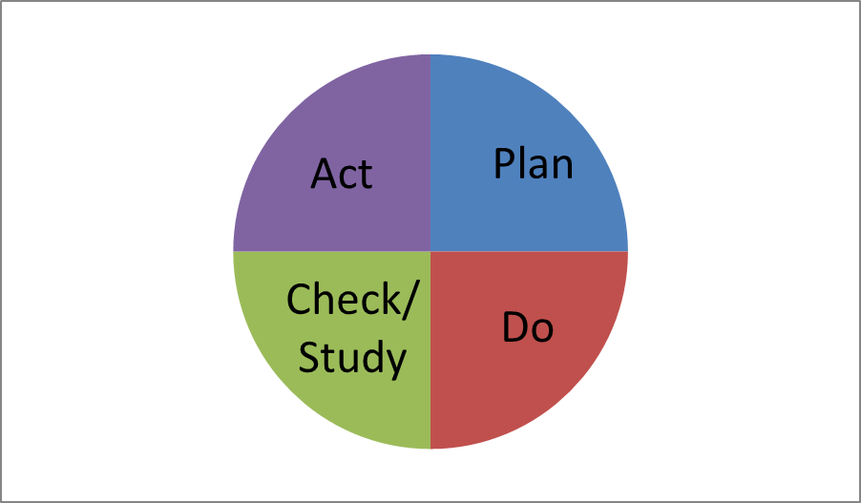
2.5 Problem Solving and Decision Making
Process Improvement Flowchart
- Shewhart -
Plan-do-check-act (PDCA)
Improvement Methodology
- Deming -
Plan-do-study-act (PDSA)

Slide 18
8D process
Standardized Problem-solving Process (Chrysler, Ford, GM):
8 disciplines (8D)
D-0 Decide to use the 8D Process
D-1 Establish Team
D-2 Describe Problem
D-3 Implement Interim Containment
D-4 Find Root Cause
D-5 Develop alternate solutions
D-6 Implement Permanent Corrective Action
D-7 Prevent Recurrence
D-8 Congratulate Team

Slide 19
2.7 S⁴/IEE DMAIC Define Phase Execution
Define phase: describes the CTQ/business issue, the customer, and the involved core business process.
Problem statement is formulated;
A 2-3 sentence problem statement
Focus on the symptoms and not the possible solution.
Process is defined.
Identification of both internal and external customers;
Development of high-level process map – four-seven steps
Initiation of SIPOC:
Suppliers, Inputs, Process, Outputs, Customers

Slide 20
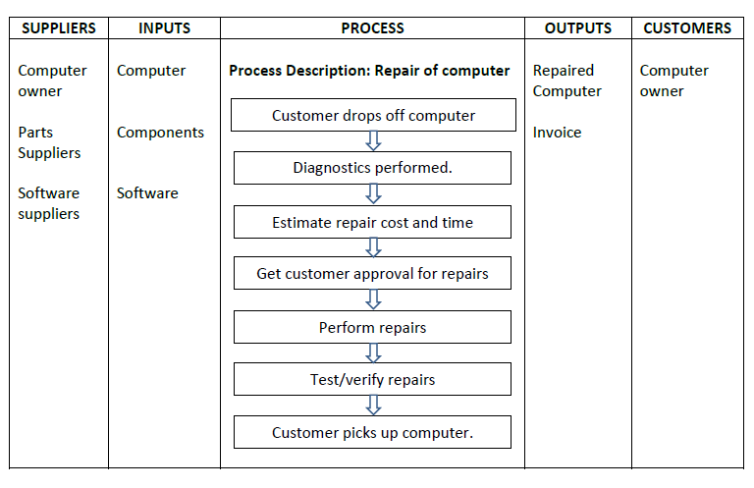
SIPOC Example

Slide 21
2.7 S⁴/IEE DMAIC Define Phase Execution: Focus Areas: Project Scope
Project scope is determined
Identification and definition of what is to be improved;
The project scope needs to be sized correctly and documented in a project charter format.
Projects should be large enough to justify the investment of resources, but small enough to ensure problem understanding and development of sustainable solutions.
The scope should accurately define the bounds of the project so project creep is avoided.

Slide 22
2.7 S⁴/IEE DMAIC Define Phase Execution: Focus Areas: Measurements
Measures are defined
Definition of the CTQ/30,000-foot-level metrics;
Identification of specific process metrics
Estimation of COPQ/CODND;
The financial liaison should work closely with the project leader and champion to create a cost-benefit analysis for the project.
Targeted improvement goals should be SMART.

Slide 23
2.7 S⁴/IEE DMAIC Define Phase Execution: Focus Areas: Stakeholders
Stakeholders (finance, managers, people who are working in the process, upstream/downstream departments, suppliers, and customers) need to agree to the usefulness of the project and its problem statement.
All involved need to agree to the objectives, scope, boundaries, resources, project transition, and closure of the project charter.
The details of the charter should be updated as the project proceeds and stakeholders informed of progress.

Slide 24
2.7 S⁴/IEE DMAIC Define Phase Execution: Focus Areas: Project Team
Team members should be selected by the champion and project leader (e. g., black belt) such that they provide different insights and skills (e.g., self-facilitation, technical/subject matter expert) needed for the successful completion of the project in a timely fashion.
Names, roles, and amount of time for project dedication should be addressed for each team member.
.

Slide 25
Related Assignments
No assignments associated with this lecture.

